Slide 1
Wrapper Method for Feature Subset Selection
Prof.Aruna Malapati

Slide 2
Learning Objective
Formulate the problem of wrapper based subset selection
List and apply wrapper based subset selection

Slide 3
Wrapper Based Methods
Greedy Based algorithms
Agnostic to the machine learning models chosen.
Sequential feature selection algorithm add or remove one feature at a time based on the classifier performance until a desired criterion is met.
Notes:
Use a classifier to evaluate a feature subset

Slide 4
Algorithm for Wrapper based method
Input: large feature set Ω
Identify candidate subset S ⊆ Ω
While !stop_criterion()
Evaluate error of a classifier using S.
Adapt subset S.
Return S.
Training data
Complete feature
Subset
Wrapper Feature Subset Selection
Search
Feature
subset
Predictive
accuracy
Machine Learning Algorithm
Commonly used Stop criterions
Increase / Decrease in Predictive accuracy
Predefined number of features is reached
Final feature Subset
Machine Learning Algorithm
Notes:
WRAPPER BASED FEATURE SUBSET SELECTION: In this methods the search algorithm outputs a feature subset which is again used by the ML algorithm and the prediction accuracy is obtained which is fed to the search algorithm and then it proceeds and finally it outputs the final subset.

Slide 5
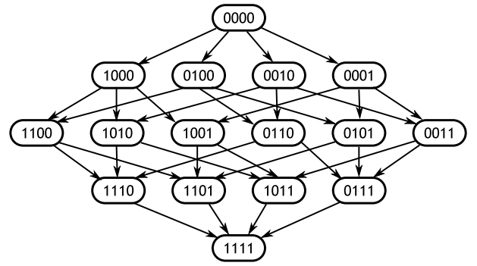
Sequential forward selection(SFS)
1. Start with the empty set 𝑌₀ = {∅}
2. Select the next best feature 𝑥⁺ = arg max 𝐽(𝑌_{𝑘} + 𝑥)
3. Update 𝑌_{𝑘+1} = 𝑌_{𝑘} + 𝑥⁺ ; 𝑘 = 𝑘 + 1
4. Go to 2
𝑥∉𝑌_{k}
Notes:
Step for
If features are redundant you may not use all of them hence we can find all uncorrelated features. You can arbitrarily start with a feature and keep adding other feature and if you find correlation with the new added feature we can discard them.
We also have to eliminate irreverent features

Slide 6
Sequential Backward selection(SBS)
1. Start with the full set 𝑌₀ = {X}
2. Remove the worst feature 𝑥⁻ = arg max 𝐽(𝑌_{𝑘} - 𝑥)
3. Update 𝑌_{𝑘+1} = 𝑌_{𝑘} - 𝑥⁻ ; 𝑘 = 𝑘 + 1
4. Go to 2
𝑥∈𝑌_{k}
Backwards selection is frequently used with random forest models
Notes:
recursive feature elimination
Therefore, the subset size is a tuning parameter for RFE.

Slide 7
Pros and Cons of Greedy Sequential Algorithms
Pros
Highest performance
Cons
Computationally expensive
Memory intensive

Slide 8
Thank You!
In our next session:Implementing Feature selection using Python

